Slide 1

FARM SUPPLY
Case Study Review
Edleman
IG Managed Services
Notes:
Founded in 1948 (71 years)
Manufacturer of niche use tractors & farming equipment
3rd largest seller of tractors & side-by-sides in the US, recently expanded into apparel & accessories
Side by sides are 4 wheeled dune buggies – think Polaris
Past 3 yrs, slower market growth & revenue
Doesn’t make sense with predicted market growth for this industry, clearly a technology issue: https://www.gminsights.com/industry-analysis/agriculture-equipment-market

Slide 2

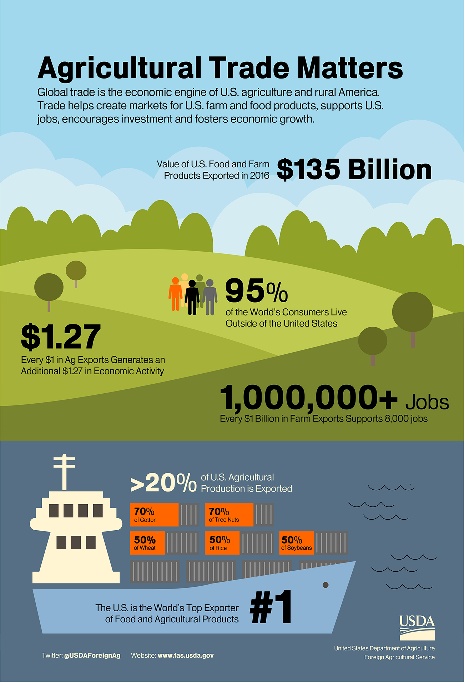
CONTEXT
Agricultural Trade Matters
Farm tractors accounted for over 50% of the market share in 2018
Agricultural Equipment Market size was about 135 Billion USD in 2016 and 140 Billion in 2018
Forecasted CAGR is 6% for 2018 to 2024
Projected 2024 value is 200 Billion USD
Shipments & Exports of equipment generated an additional 15 million for US businesses
Stagnated Growth? Despite growth projected for the agricultural equipment market, EFS customer acquisition stagnated & revenue declined…
IG Managed Services
Notes:
Global Market Insights is responsible for publishing insights regarding various industries based on a collection of private and public information data reports, government reports, and industry leading analysts. You can check out their website via https://www.gminsights.com/
Compound Annual Growth Rate (CAGR) is a business and investing specific term for the geometric progression ratio that provides a constant rate of return during that time period. CAGR is not an accounting term, but often used to describe the revenue potential of a business.
CAGR is one of the most accurate ways to calculate and determine returns for anything that can rise or fall in value over time.
https://www.gminsights.com/industry-analysis/agriculture-equipment-market
https://www.investopedia.com/terms/c/cagr.asp

Slide 3

CHALLENGES
Top Three Challenges Edleman Farm Supply Faces
Data Analysis
Inventory Management
Customer Data
Engagement
Community Events
Availability
Instructional Guides
Website Interaction
Service Uptimes
IT Monitoring Tools
Supply & Delivery
Social Media
Vendor Communication
Internal Enablement
Technical Documentation
Data Loss Prevention
Transactional Processing
Locale Risk Assessment
IG Managed Services
Notes:
Data Analysis
Inaccurate and incomplete data wastes time and money.
On average, corporate data grows at 40% per year
25-34% of email addresses become outdated every year
18% of all telephone numbers change every year
Approximately 20% of the average database is dirty
Bad data can increase customer acquisition costs by over 27% or $100 per dirty record
If a business had a 100,000-record database, the cost over 3yrs would amount to roughly $3,920,000 USD
Engagement
Pocatuah events, art festival
Vendors understanding what incentives are, Ark Naturals
Sales force feel connected to the energy and track of the company as well as each other
Website depending on transactions structure
Availability
Leaving DevOps to the colocation teams in KY
KY is the leading area for colocation centers thanks in part to the strategic headquarters of UPS, Samsung, etc
KY has the nations cheapest electricity and power consumption costs
Content delivery to customers, vendors, etc, is what will put you on the map for SEO but it will also allow people to return to you due to bookmarks, cookies only go so far

Slide 4



STEP 1: STABILIZE
SOLUTIONS
Improve stability of service availability & uptimes
Regulate maintenance windows
Communicate status states clearly
Take advantage of colocation DCs
Elimination of friendly-fire data-loss
Creation of productive & traceable workflows for development
Pipeline automation & reporting
At Insight Global, we know that Rome wasn’t built in a day. Lasting results take time to implement, which is why we are presenting you with strategic platform separated into phases. Where together as a team, we can gain momentum, without tackling too much at once.
RHEL ∆ Ubuntu Enterprise
On-Prem ∆ Managed Colocation*
Cloud Redundancy
Stored/Bot Procedural Workflows*
Roadmaps for Dev/Feature/Bugs
JIRA/Spiceworks/Ticketing*
CircleCI/Travis/Jenkins*
Continuous Integration/Deployments*
STEP 2: CONNECT
Connect with the local community
Improve digital marketing
Leverage social media
Targeted campaigns & sales events
Create brand ambassadors
Customer care & rewards programs
Open communication with vendors
IG Managed Services

Slide 5


STEP 3: INTEGRATE
SOLUTIONS
Adopt a CRM & ERP strategy
Foster better inter-departmental communication in teams
Improve premier B2B partnerships
Homogenize inventory across POS systems & online platforms
Cohesion between payment processors, GVMs & gateways
At Insight Global, we know that Rome wasn’t built in a day. Lasting results take time to implement, which is why we are presenting you with strategic platform separated into phases. Where together as a team, we can gain momentum, without tackling too much at once.
Salesforce Platform(s)*
POS Connection with Inventory/ERP*
Payment Processor Optimization (Authorize)*
NCR Authentic or PA-DCC Compliant Processor*
User Feedback Surveys
Customer Engagement Forms on Signup/Signin
User driven A/B testing for content layout
Portal management profiles for users/vendors
Retargeting campaigns for specific sales*
STEP 4: ANALYZE
Track inventory movement throughout the supply chain
Advertising campaigns & brand awareness performance
Remarketing strategy with social media & digital marketing
Locale analysis for brick & mortar
User research & interaction surveys
IG Managed Services
Notes:
All of these suggestions should be taken at face value, due to their specificity without proper answers to the questions that would preclude any information we could offer with any substantial certainty.
Payment processors like NCR Authentic for instance, are utilized for loans, and banking processes where a banking relationship does not already exist, or cheaper initialization rates are desired. https://www.ncr.com/banking/payment-transaction-processing

Slide 6

CALENDAR
Let’s meet again for specifics regarding times, costs and tech…
IG Managed Services

